Slide 1


Slide 2
Movify

Slide 3











movify
Home
TV Shows
Movies
New & Popular
My List
KIDS
Movie recommendation system
A project that recommends movies based on user preferences, ratings, and viewing history using machine learning algorithms. It personalizes suggestions to enhance the user's movie-watching experience.
Play
More Info
SUBTOPICS OF THE REPORT
1 2 3 4 5 6

Slide 4
Introduction
With so many movies available, finding the right one can be challenging.
Movie recommendation systems use algorithms and data analysis to suggest films based on user preferences, making the search process more efficient and enjoyable.
Movie recommendation systems analyze user ratings, viewing history, and genres to identify preferences.
The goal of these systems is to simplify movie selection, helping users quickly find content that suits their tastes.

Slide 5
EXISTING SYSTEM
MovieLens: Provides personalized movie recommendations based on user ratings and preferences. Users can rate movies they've watched, and the system suggests films based on these ratings and similar user profiles.
TasteDive: Recommends movies, music, and other media based on user interests. By analyzing user preferences and comparing them to others with similar tastes, it suggests new content that users might enjoy.
Letterboxd: A social platform for movie lovers to track and review films. It offers recommendations based on user activity, ratings, and reviews, and also lets users follow others with similar tastes to discover new movies.

Slide 6
ADV & DIS-ADV
Advantages:
1. Dataset: Many systems have access to extensive datasets, which improves the accuracy and relevance of recommendations.
2. Open Source: Some systems are open source, allowing for customization and community contributions.
Disadvantages:
1. UI: User interfaces can sometimes be cluttered or not user-friendly, affecting the overall experience.
2. Ads: Some systems may display ads, which can be distracting or disrupt the user experience.
3. Limited Content: The range of content available for recommendations might be limited, especially for niche genres or less popular films

Slide 7
PROPOSED SYSTEM
Proposed Systems:
1. Watchlist: Users can maintain a personalized watchlist to keep track of movies they want to see.
2. Email Notifications: Users will receive notifications through email about new recommendations and updates.
3. Preference-Based Recommendations: Recommendations will be tailored based on favorite preferences set during initial login and through user search and watch history.
4. Nostalgia Recommendations: Movies that evoke nostalgia based on the user’s age, calculated during login, will be suggested to enhance their viewing experience.
These features aim to provide a more personalized and engaging user experience

Slide 8
ADVantages
Advantages:
1. Personalization:
- Watchlist: Helps users keep track of movies they want to watch.
- Preference-Based Recommendations: Tailors suggestions based on user preferences and history, improving relevance.
- Nostalgia Recommendations: Enhances user engagement by suggesting movies that evoke a sense of nostalgia.
2. User Engagement:
- Email Notifications: Keeps users informed about new recommendations and updates, increasing interaction with the system.
3. Enhanced Discovery:
- Provides personalized suggestions and notifications, making it easier for users to discover movies they might enjoy.

Slide 9
Disadvantages
Disadvantages:
1. Data Privacy:
- Collecting and analyzing personal data (like age and preferences) may raise privacy concerns among users.
2. Complexity:
- Implementing and maintaining personalized recommendations and nostalgia features can be complex and resource-intensive.
3. User Overload:
- Frequent email notifications might overwhelm users if not managed carefully, potentially leading to disengagement.
4. Limited Scope:
- Nostalgia recommendations are based on age, which might not always accurately reflect users' nostalgic preferences.

Slide 10
System development model:
Phase | Activities | Deliverables
1. Requirement Analysis | Gather requirements for movie recommendations, user authentication, and API integration. Define functionality for different movie genres and user interface elements. | Specifications
2. System Design | Create database schema and architectural design for recommendation engine and Streamlit app. Develop UI/UX layout and workflow for search, selection, and recommendation features. | System Design
3. Implementation | Code frontend (Streamlit) and backend modules (recommendation engine, search, API). Develop and test database functions for storing and retrieving user and movie data. | Codebase (Source code)
4. Integration and Testing | Conduct integration testing for all modules and validate recommendation accuracy. Run unit and security tests for login, data handling, and API responses. | Test Reports
5. Deployment | Deploy app to server or cloud; configure database and API for production. Verify API keys, environment setup, and deployment compatibility. | Deployment Of System
6. Maintenance | Monitor app, update algorithms based on feedback, and manage database changes. Fix bugs, enhance features, and support ongoing improvements. | Updates System

Slide 11
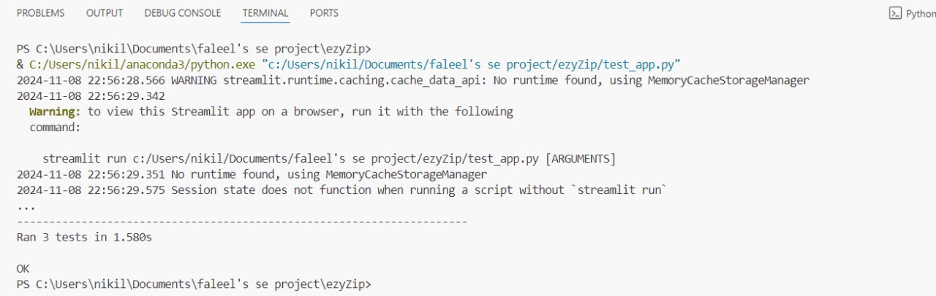
Unit testing output

Slide 12
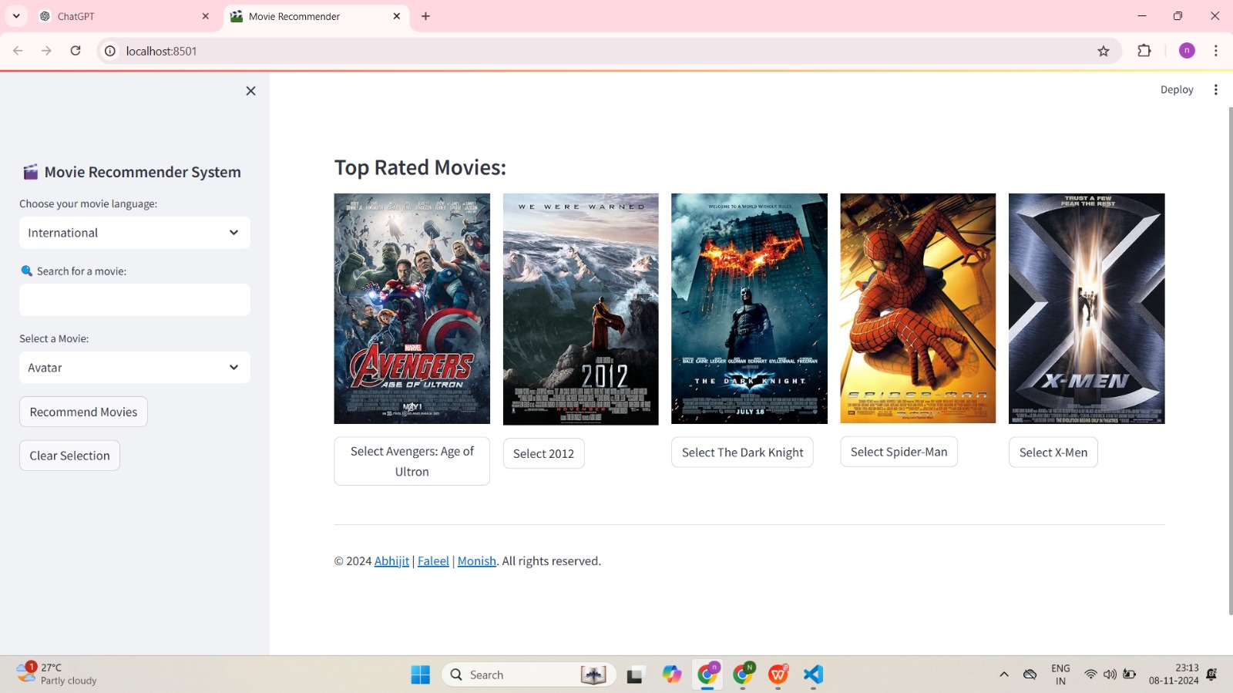
Model
output

Slide 13
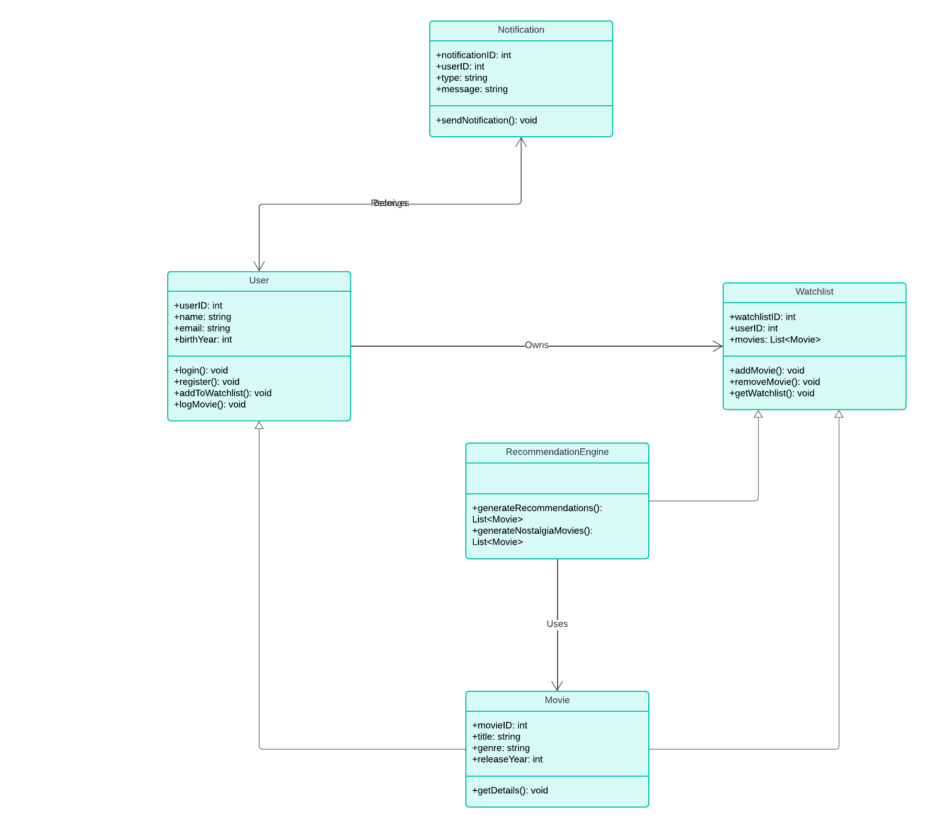
Class
diagram

Slide 14
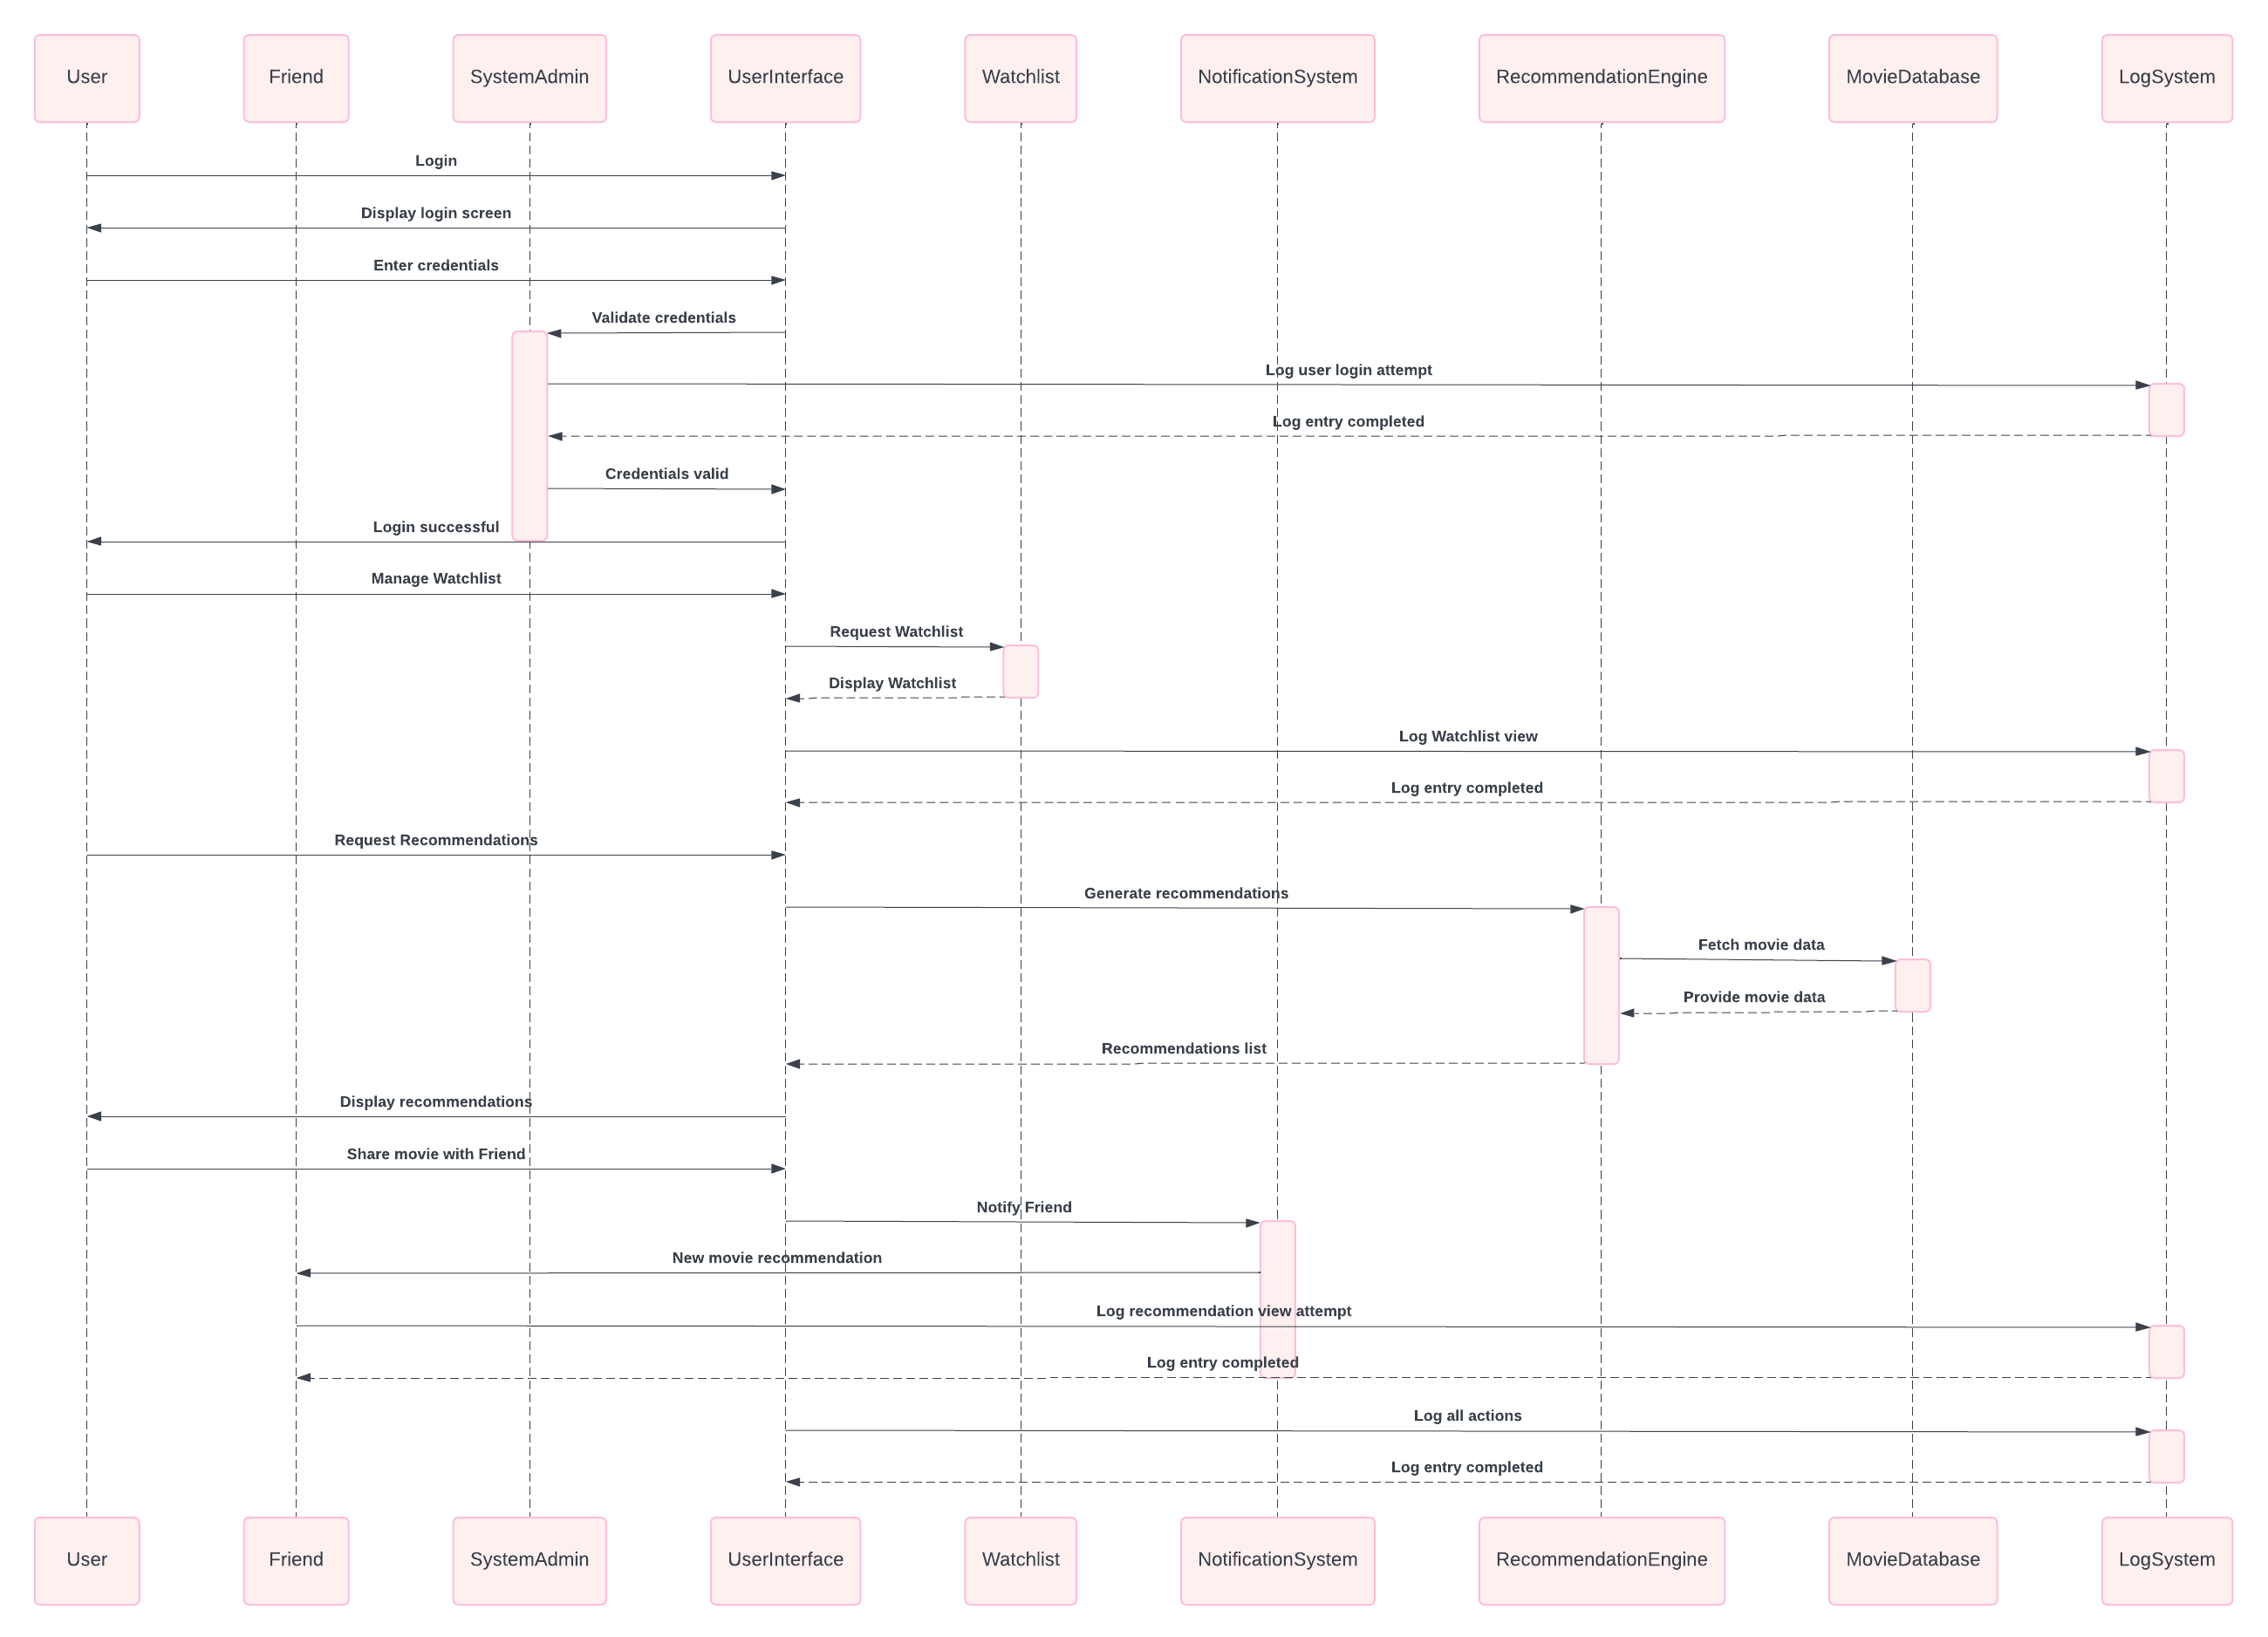
Sequence diagram

Slide 15
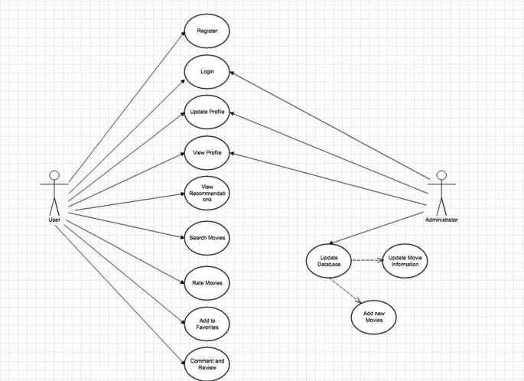
Use case

Slide 16
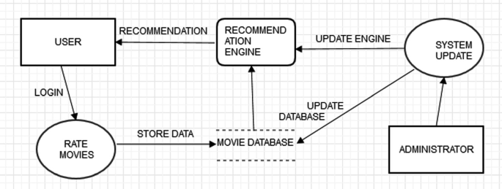
Dfd - Level 0

Slide 17
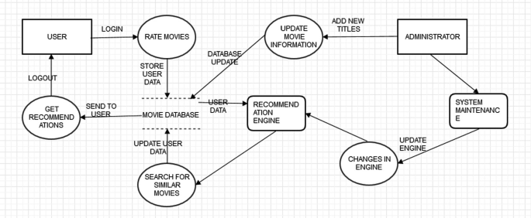
Dfd - Level 1

Slide 18
srs
Product Functions
Provide personalized movie recommendations.
Send notifications based on user preferences and search history.
Recommend nostalgia movies based on the user's birth year.
Allow users to log movies after watching them.
Allow users to add movies to a watchlist.
Send "check out this movie" notifications to friends.
User Registration and Authentication
Notifications
Nostalgia Movie Recommendations
Watchlist Management
Movie Logging

Slide 19
Non-functional requirements:
4. Security
• Protection: HTTPS for secure data.
• Access: Login for specific features.
5. Maintainability
• Code: Clear and documented.
• Logs: Error and activity logs.
6. Portability
• Compatibility: Major OS and browsers.
7. Efficiency • Resource Use: Low CPU/memory.
This keeps requirements brief and to the point.
1. Performance
• Speed: Recommendations in 2 seconds.
• Scalability: 10,000 users at once.
2. Usability
• Ease of Use: Simple interface.
• Accessibility: Supports screen readers.
3. Reliability
• Uptime: 99.9%.
• Error Handling: Friendly error messages.

Slide 20
CONCLUSION
This movie recommendation MOVIFY project successfully delivers a user-friendly system that provides fast, personalized movie suggestions. By utilizing efficient algorithms, data handling, and API integration, it offers recommendations across various languages (Tamil, Indian, and International) with easy search options and detailed movie info.
The project adheres to essential non-functional requirements like performance, usability, security, and reliability, ensuring a smooth and secure experience for users. With its clear structure and scalability, this system can be further enhanced and adapted to meet future needs, making it a robust foundation for personalized content recommendations in the entertainment domain.

Slide 21
Reference
1. Harper, F. M., & Konstan, J. A. (2015). The MovieLens datasets: History and context. ACM Transactions on Interactive Intelligent Systems (TiiS), 5(4), 1-19.
2. Kumar, R., & Thakur, N. S. (2019). An approach towards hybrid movie recommendation system. International Journal of Recent Technology and Engineering (IJRTE), 8(3), 7173-7179.
3. Bobadilla, J., Ortega, F., Hernando, A., & Gutiérrez, A. (2013). Recommender systems survey. Knowledge-Based Systems, 46, 109-132.
4. Musto, C., Semeraro, G., Lops, P., & de Gemmis, M. (2015). A comparison of techniques for recommending movies in a content-based framework. Proceedings of the 9th ACM Conference on Recommender Systems.
5. Chen, K., Zhang, J., & Cao, L. (2014). A personal movie recommendation system based on collaborative filtering. Procedia Computer Science, 4, 228-234.
6. Said, A., & Bellogín, A. (2014). Comparative recommender system evaluation: Benchmarking recommendation frameworks. Proceedings of the 8th ACM Conference on Recommender Systems, 129-136.

Slide 22

THANK YOU. FOR LISTENING!
Reporters: Abhijit R, Faleel Mohsin M, Monish Raja Rathinam M
Subject: AD19541-Software Engineering
Teacher: Dr.J.Manoranjani
Questions? Clarifications FAQ About Us Help Center

